Slide 1
DEFAULT OF CREDIT CARD CLIENTS
TAHA Bin AMER, PRANAV VINOD
Cis 490 – Machine Learning
University of Massachusetts Dartmouth

Slide 2
Introduction
The aim of this project is to analyze the credit card client's dataset and gain meaningful insights from it.
We shall employ various data analysis techniques to explore the dataset for any ambiguities. Moreover, we will be practicing logistic regression as well as classification trees to predict whether a client is predicted to default on his/her credit card payment or not.
Lastly, but certainly not least we will be analyzing the outcomes from both these techniques and then compare and contrast the output generated by both models.

Slide 3
Data Description
This dataset contains information on default payments, demographic factors, credit data, history of payment, and bill statements of credit card clients in Taiwan from April 2005 to September 2005.
There are 25 attributes in total with default.payment.next.month being our target variable (Y).
Other attributes include: LIMIT_BAL, SEX, MARRIAGE, AGE, EDUCATION, PAY_MONTH, BILL_AMOUNT, PAY_AMOUNT.

Slide 4
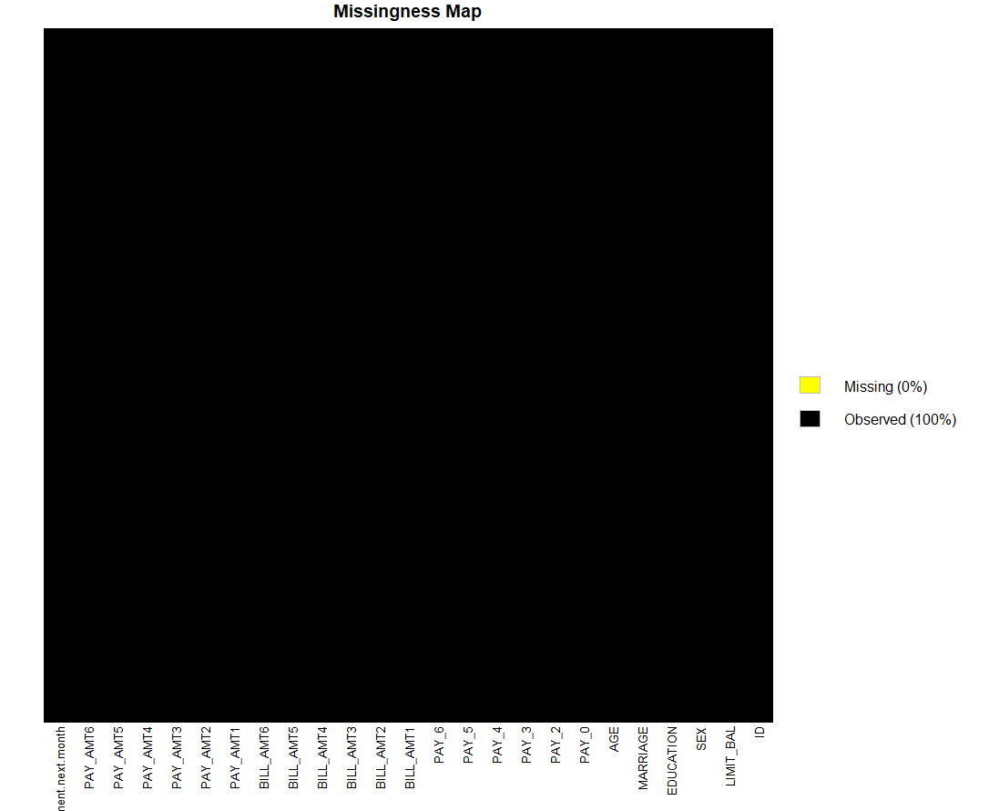
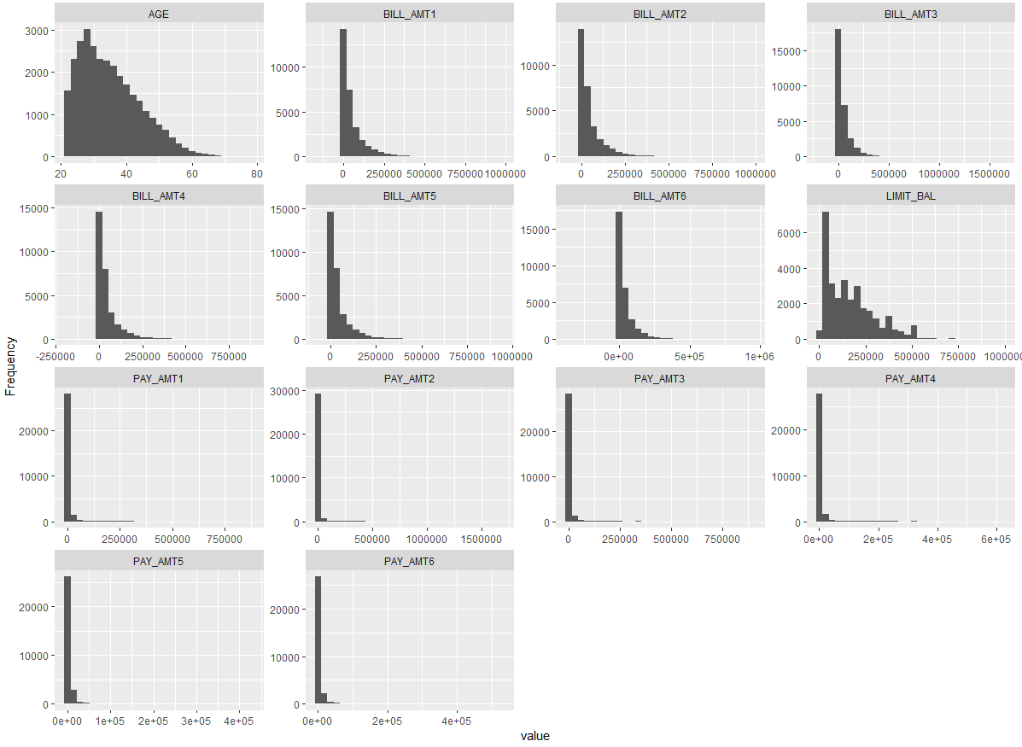
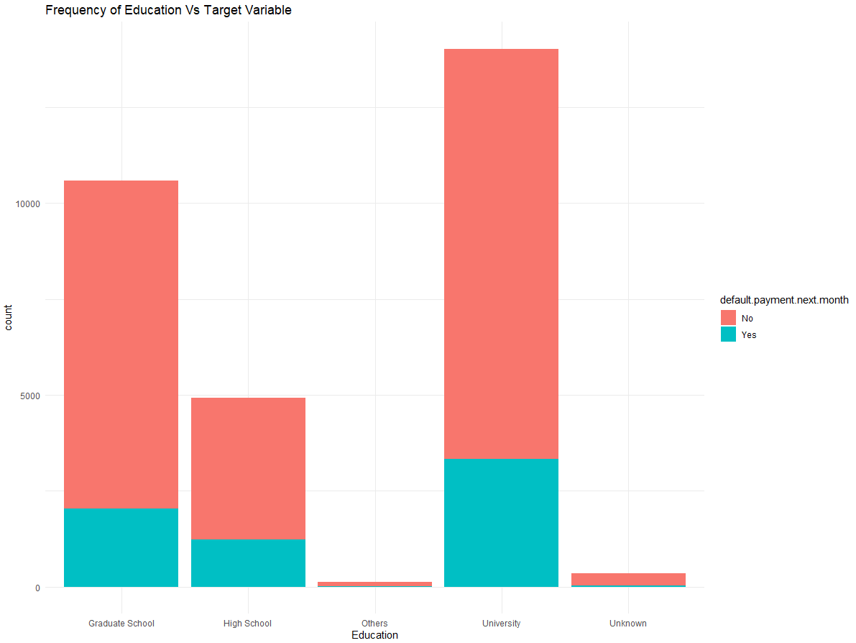
Data Exploration

Slide 5
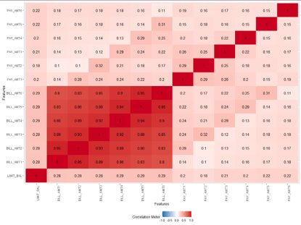
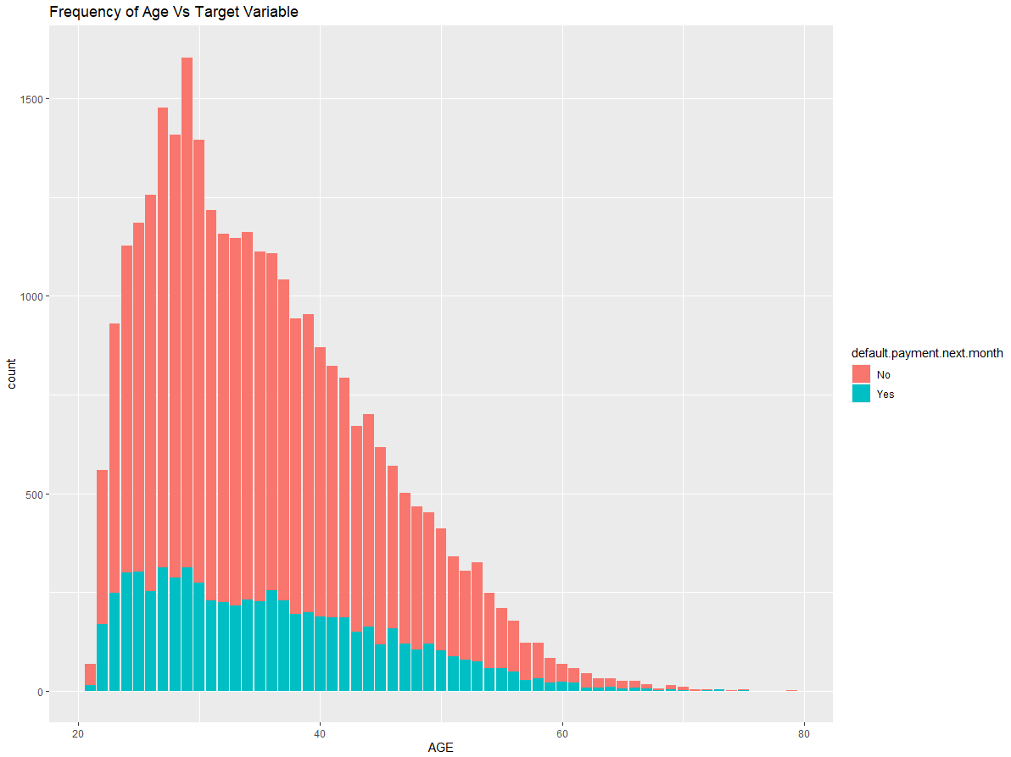
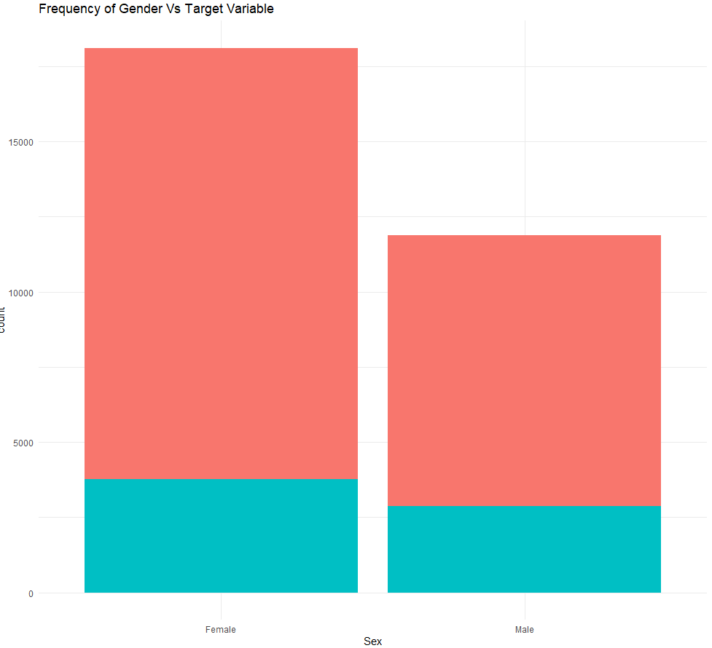
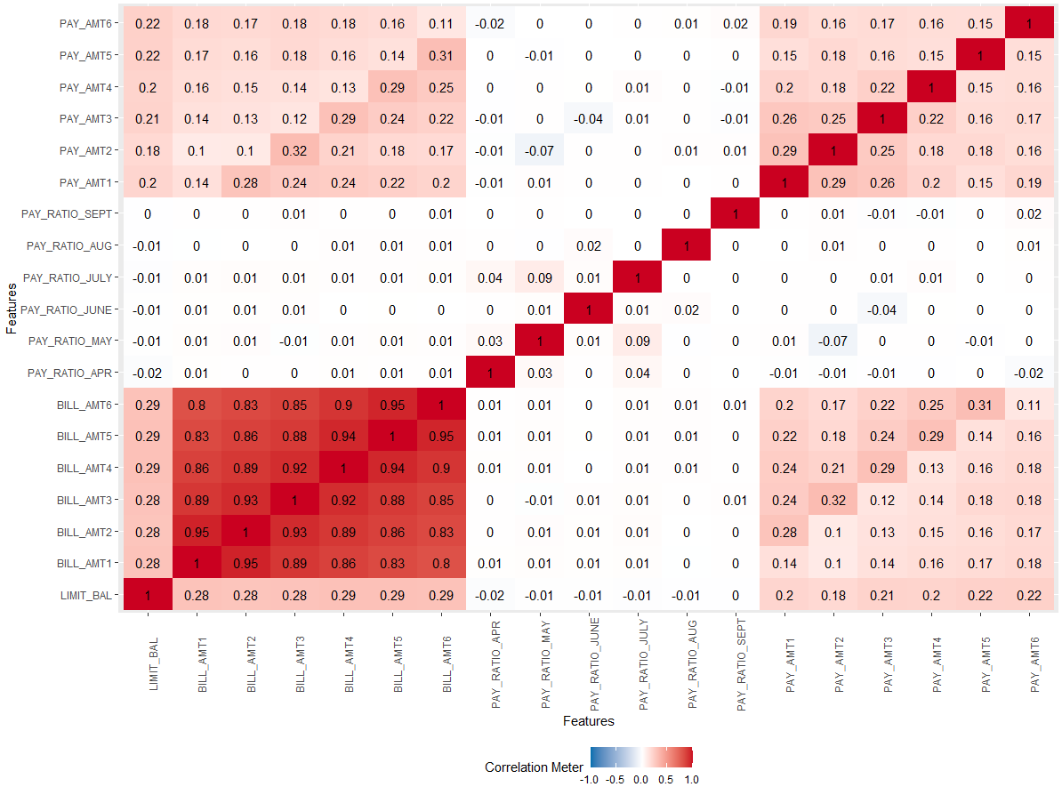
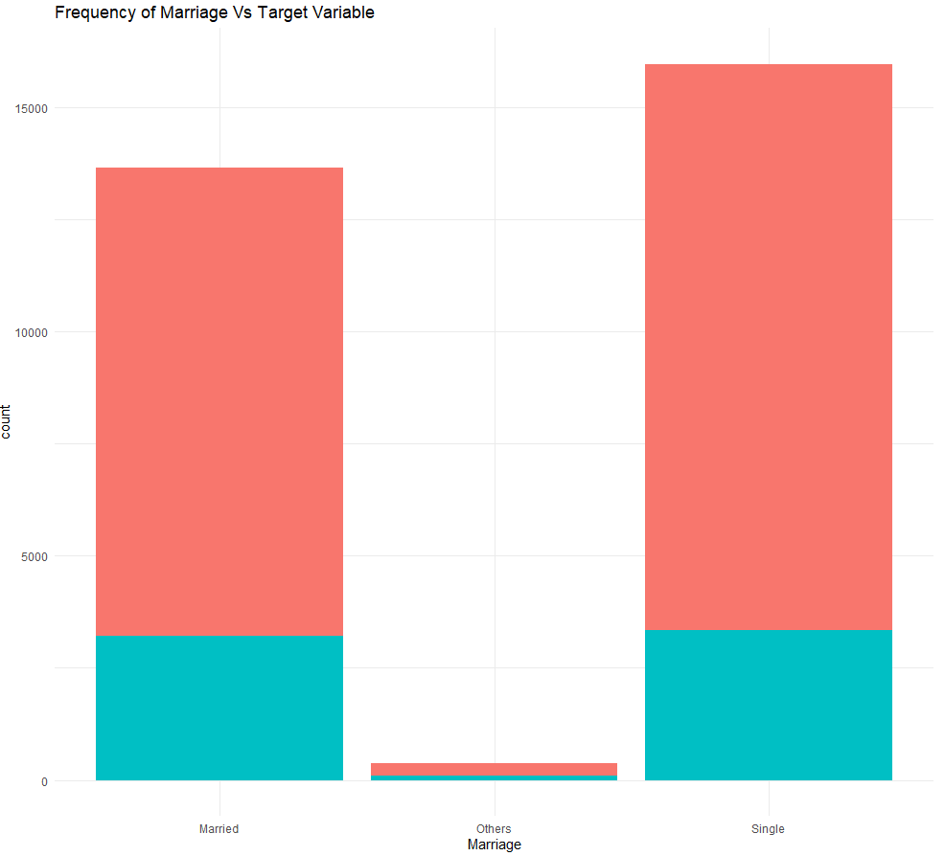
Data Exploration (Contd.)

Slide 6
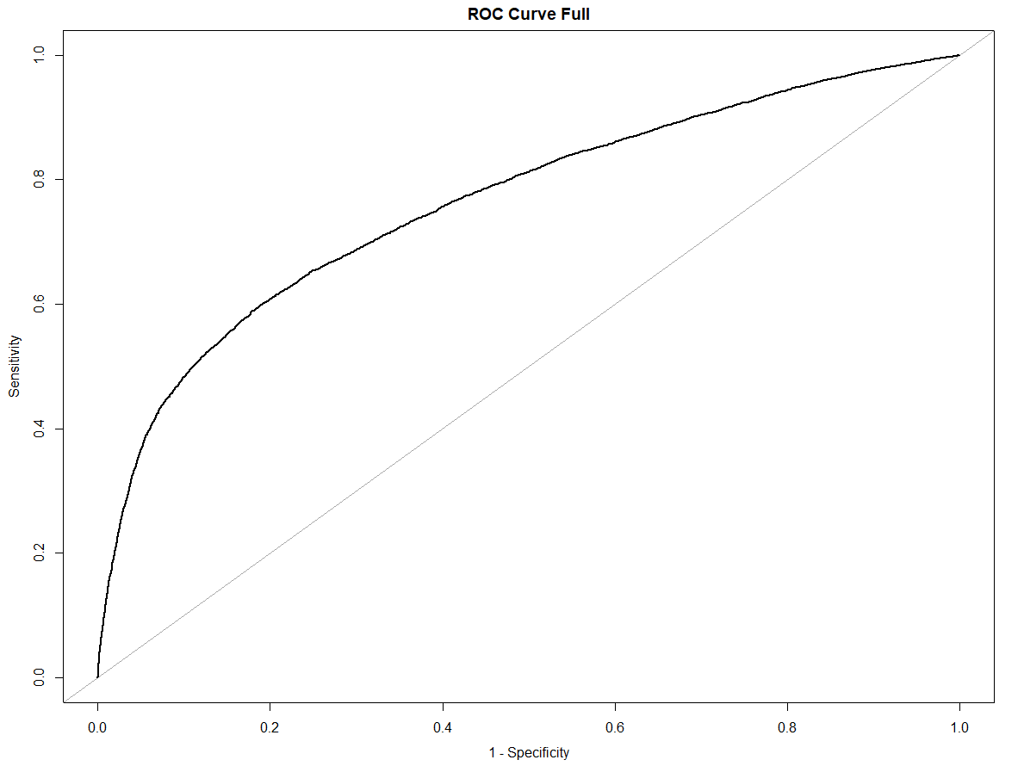
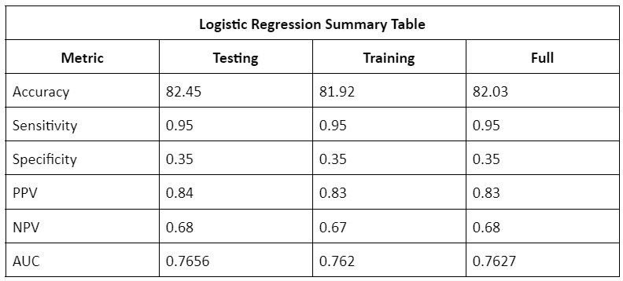
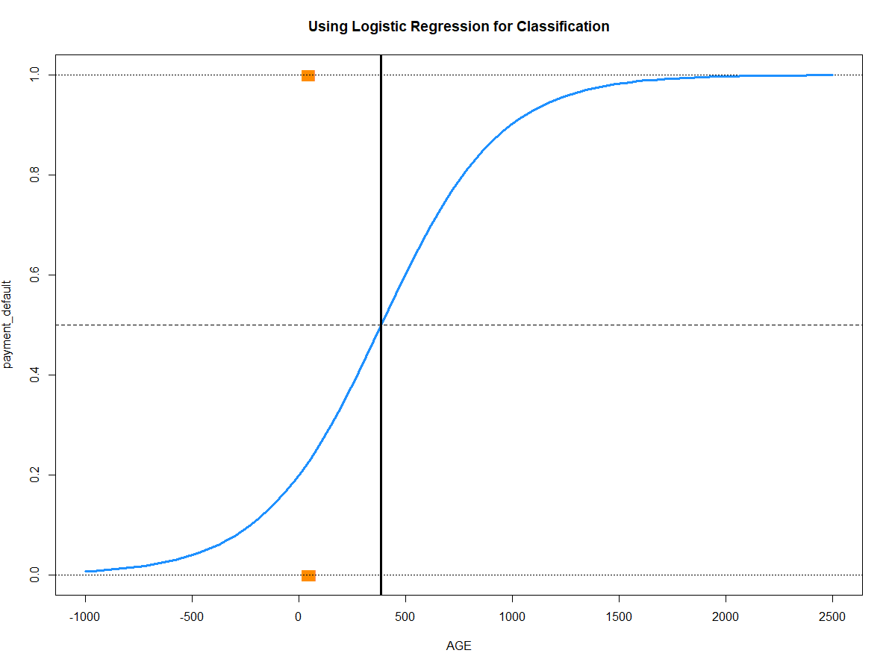
Logistic Regression
We split the dataset into 80% train and 20% test. SEX and MARRIAGE we were weak predictors according to their Information Value.
Using Step AIC methodology to find the best subset of attributes our model accuracy turned out to be 81.92% and AUC = 0.76.

Slide 7
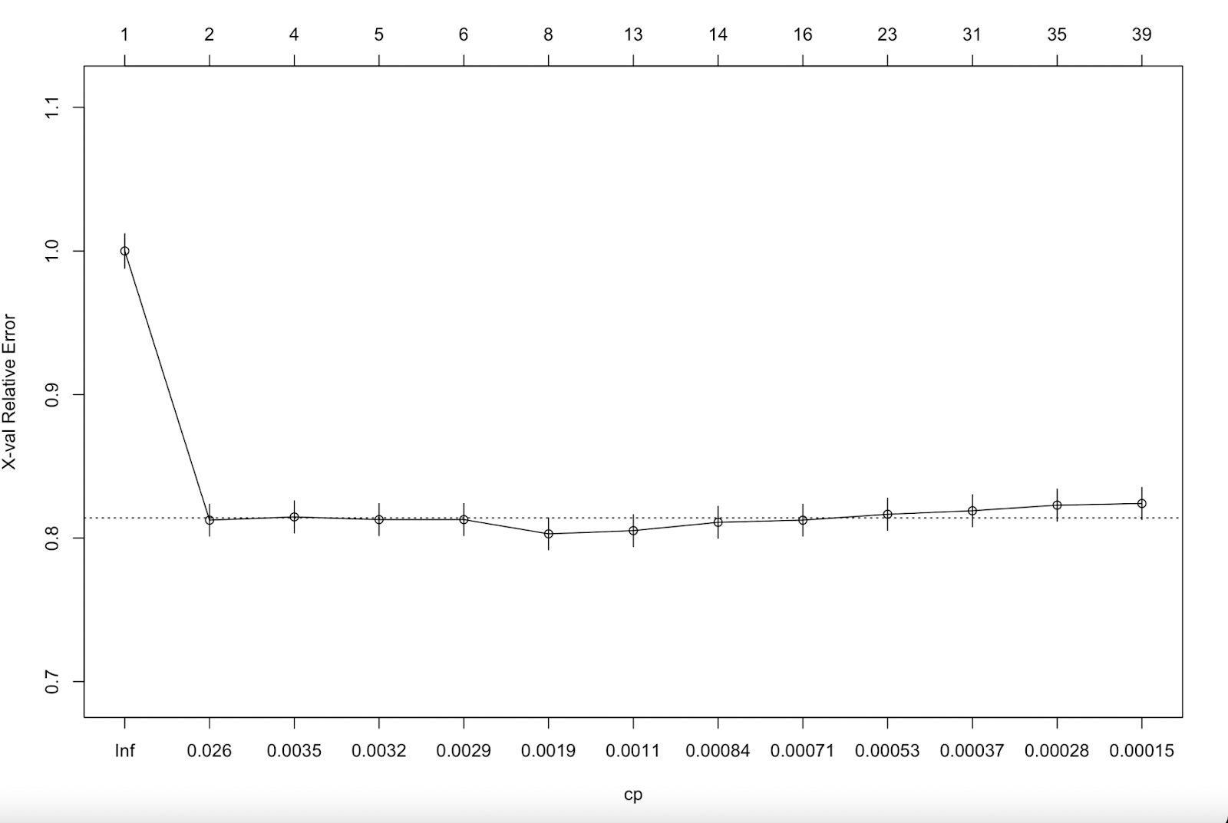
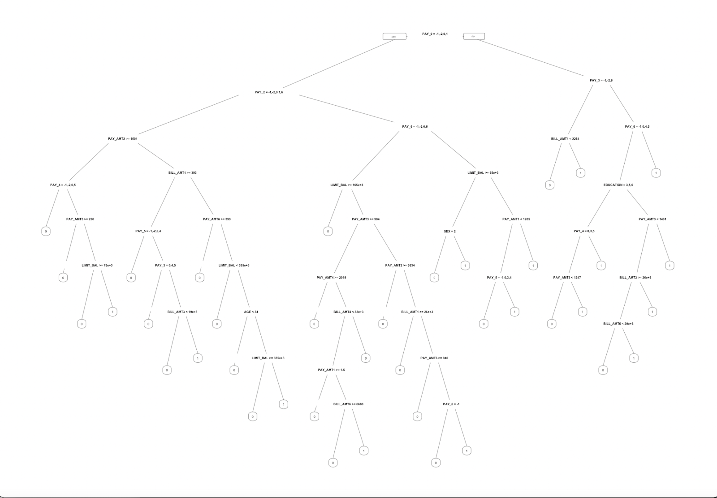
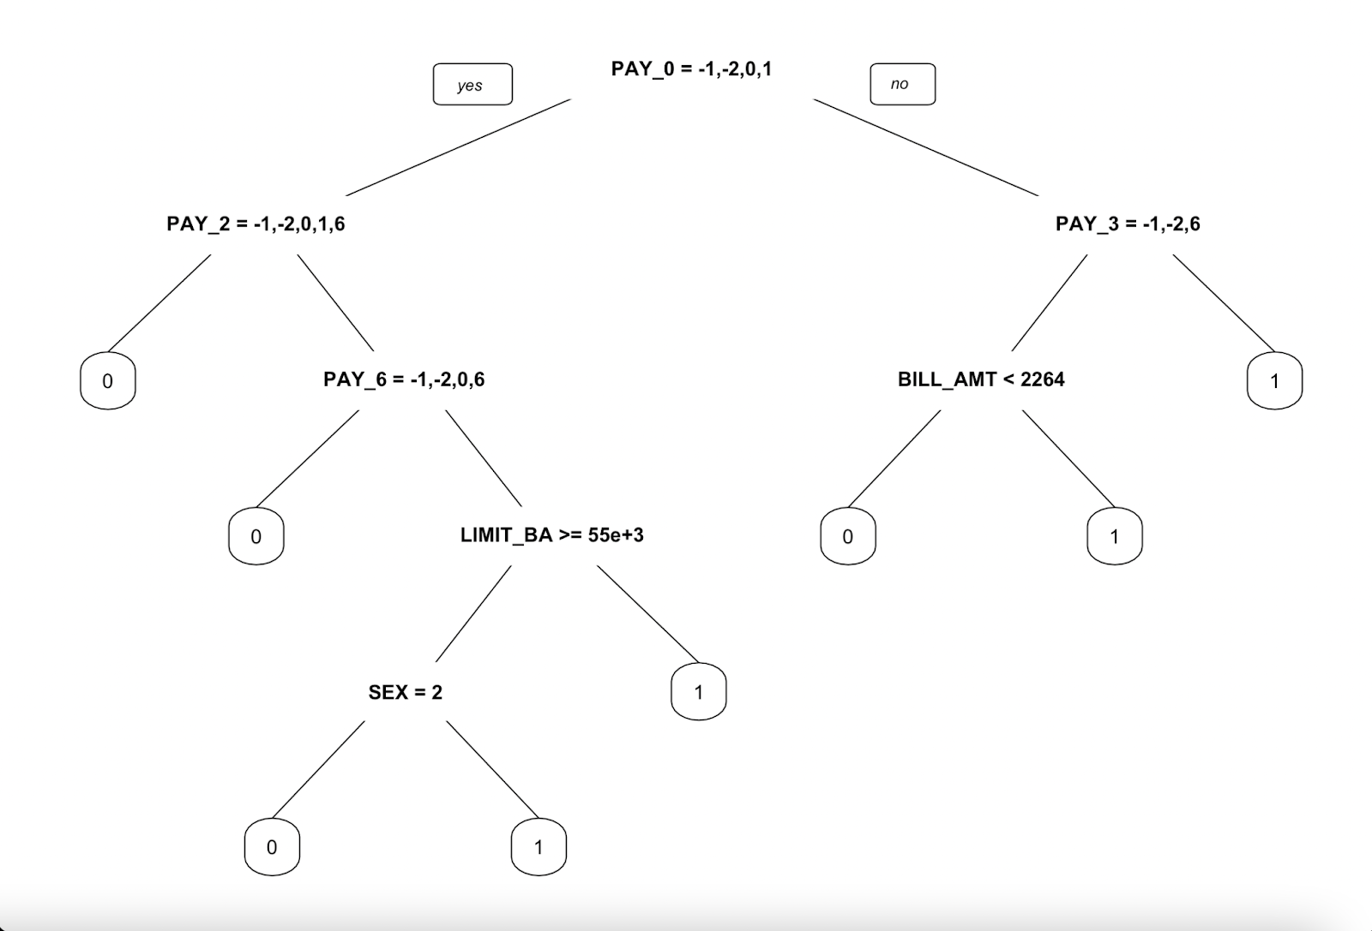
Classification Tree
To create this classification tree, we used recursive binary splitting followed by weakest link pruning.
On creating a full tree, we got a tree of size 39 which was pruned down to a tree of size 8.
The most important predictor was PAY_0 followed by PAY_2 and PAY_3.

Slide 8
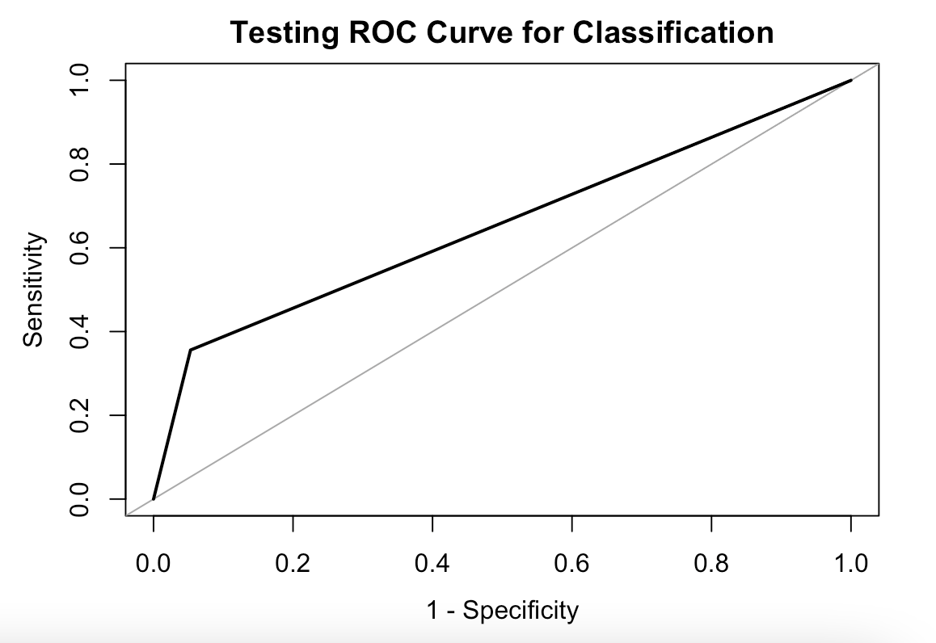
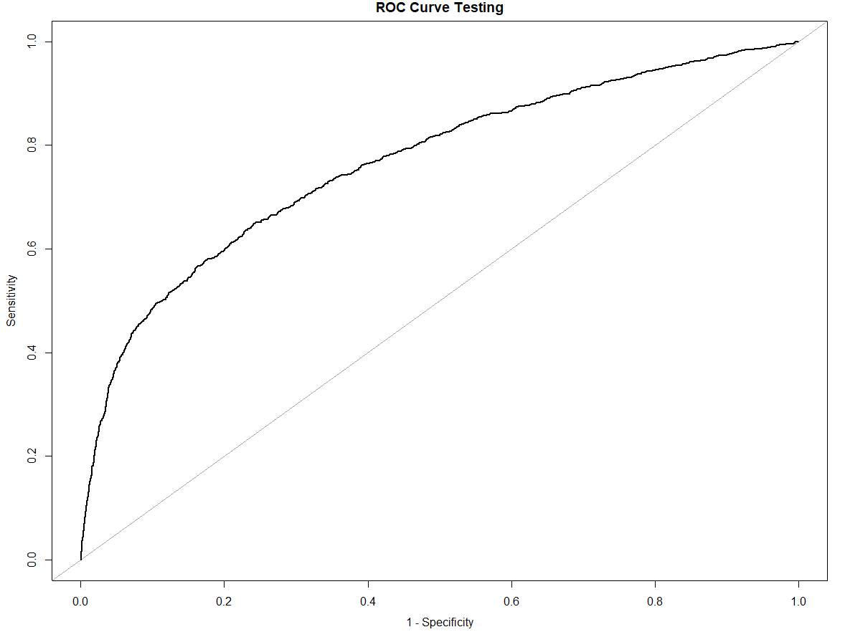
Comparison b/w models
Using testing data to compare the models:
Metric | Classification Tree | Logistic Regression
Accuracy (%) | 82.2 | 82.45
Sensitivity | 0.84 | 0.95
Specificity | 0.67 | 0.35
PPV | 0.95 | 0.84
NPV | 0.34 | 0.68
AUC | 0.65 | 0.7656

Slide 9
Summary
Both of the models have similar accuracy. But the area under the ROC curve for both models differs by a significant amount. For the logistic regression model, the area under the curve is 0.76 whereas for the classification tree model, the area is 0.65. This indicates that overall the logistic regression model is a better model for classification than the tree model.
Logistic regression is also better at predicting people who will not default on their payments with a sensitivity of 0.95 as compared to 0.84.
Whereas, the tree based model outperforms the logistic regression model while predicting people who would default on their payments.

Slide 10
Contribution Report
•Each member contributes equally.
•Taha Bin Amer – 01972684
•Pranav Vinod – 01984464
•Group Meet and Time : Zoom – March 10: 11 pm - 12:30 am
•Zoom – March 19: 11pm – 12 am
•Zoom – March 20: 11pm- 12:30 am
Thank You!

